Slide 1
CIP - Customer Intelligence Platform
27th September 2021

Slide 2


Index
Ladbrokes SIA
Hadoop
ARC Project
US Realtime transactional data
Live Casino
Performance Improvements
Stream AWS Casia model data & serve through API / CASIA-CASINO Recommendation Data Routing to DCRM (Optimove)
CDNA Sports
Stream and Bet
Play Tech integration
Phone & Email Encryption for Snapchat integration
Scout Integration
Long Sessions
Play Breaks
CASIA - 7302 - Risky Games(E-34559)
Graphyte Integration
Notes:
Four key points

Slide 3


Ladbrokes SIA
Business use case
Technical description
Problem description: Currently, we don’t have bet recommendations for sports which would help to target players with personalized recommendations.
Label(s) impacted: All Ladbrokes & Coral Label.
Action taken: Consuming the Bet Placement, Bet Settlement, Payout Status, Event, Market, Selection, Oxirep-Commentary messages events in Realtime from Open bet over DF Kafka and made available for Model consumption, which generates bet recommendations to the players.
Business benefit: Significantly more personalized customer experience and increase in CTR (click through rate).
Architecture/Design: CIP consumes this data from DF Kafka and made available for model.
Source Events: Bet Placement, Bet Settlement, Payout Status, Event, Market, Selection, Oxirep-Commentary messages.
Notes:
Four key points

Slide 4
Hadoop
Business use case
Technical description
Problem description: We don’t have any system to execute ML,AI models to generate recommendations to understand the player behaviour.
Label(s) impacted: All GVC,LCG,US Label.
Action taken: Built Hadoop Infrastructure which has ML,AI capabilities for running ML models for generating Game, Sports recommendations.
Business benefit: Based on players behavior we can show the personalized games,sports to the players which would significantly improve CTR,
Architecture/Design: Built the Hadoop with Components HDFS, Yarn, Spark, Hive, Hue.
HDFS: HDFS is Hadoop filesystems to store the transactional, Behavioral data.
Spark: Spark is a fast and general processing engine compatible with Hadoop data.
Yarn: Yarn manages the resources in the Hadoop cluster.
Hive: Hive gives an SQL-like interface to query data stored in various databases and file systems that integrate with Hadoop. Hue: Hue is a web-based tool to access the data from Hadoop and provide the visualizations instantly.
Hue: Hue is a web-based tool to access the data from Hadoop and provide the visualizations instantly .
Notes:
Four key points

Slide 5
ARC Project
Business use case
Technical description
Problem description: In order to provide data to ML models and to ensure safer gambling, we need to provide the players’ behavioral and transactional data.
Label(s) impacted: GVC,LCG Label.
Action taken: Consuming the Bet Placement, Bet Settlement, Login, Deposit, Withdrawal, Redeem, Payout, Promo, Bonus, Wallet events and players’ behavioral events in Realtime from GVC,LCG Data centers for Model consumption.
Business benefit: Players can see the personalized recommendations of sports/games and also these models would enforce safer gambling.
Architecture/Design: CIP consumes below events in Realtime from GVC, LCG data centers over Analytics ESB.
Source Events: Bet Placement, Bet Settlement,Login,Deposit,Withdrawal,Redeem,Payout,Promo,Bonus,Wallet events and players’ behavioral events .
Notes:
Four key points

Slide 6
US Realtime transactional data
Business use case
Technical description
Problem description:
In order to provide data to ML models and to ensure safer gambling, we need to provide the players’ behavioral and transactional data.
Label(s) impacted: ALL US Label.
Action taken: Consuming the Bet Placement, Bet Settlement, Login, Deposit, Withdrawal, Redeem, Payout, Promo, Bonus, Bingo, Wallet events , players’ behavioral events in Realtime from ALL US Data centers for Model consumption.
Business benefit:
Players can see the personalized recommendations of sports/games and also these models would enforce safer gambling.
Architecture/Design: CIP consumes below events in Realtime from different US data centers over Analytics ESB.
Source Events: Bet Placement, Bet Settlement, Login, Deposit, Withdrawal, Redeem, Payout, Promo, Bonus, Bingo, Wallet events and players’ behavioral events.
Notes:
Four key points

Slide 7
Live Casino
Business use case
Technical description
Problem description:
This is to bring back the Casino players who left the platform, by awarding them with a bonus.
Label(s) impacted: All LCG label.
Action taken: Identity players who are not online but they are supposed to be online, award them a bonus.
Business benefit: To Reactivate/Retain players.
Architecture/Design: CIP consumes recommended players from ADA models for bonus rewarding and post these events to SFMC over HTTP for Realtime rewarding and communication.
Notes:
Four key points

Slide 8
Performance Improvements
Business use case
Technical description
Problem description: To avoid lag in sending Transactional/Behavioral data to Casia & Graphyte analytic systems
Label(s) impacted: All labels.
Action taken: Identified the bottlenecks in the entire pipeline and improved.
Business benefit: By the above solution, now the system can provide sports/games recommendations instantly
Architecture/Design: Scaled Services Vertically, horizontally, fixed performance bottle necks in different services in the pipeline.
Source Events: Bet Placement, Bet Settlement, Login, Deposit, Withdrawal, Promo, Bonus, Wallet events, Behavioral events.
Notes:
Four key points

Slide 9
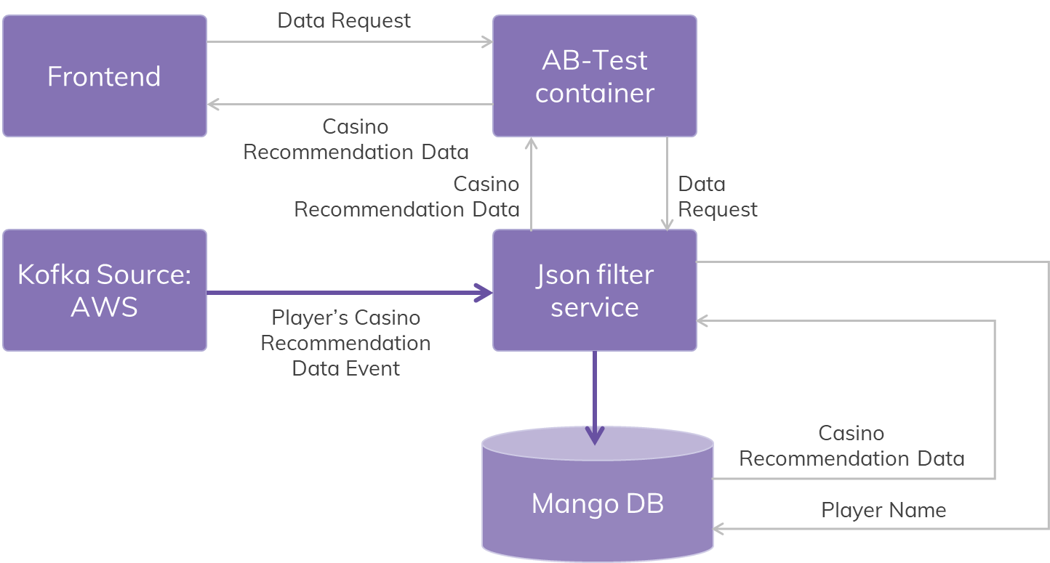
Stream AWS Casia model data & serve through API / CASIA-CASINO Recommendation Data Routing to DCRM (Optimove)
Business use case
Technical description
Problem description: Expose API for casino games home page personalization for A/B test usecases.
Routing casino recommendation events from ADA to platform (DCRM) with help of analytics ESB.
Label(s) impacted: bwin.es.
Action taken:
Streamed the AWS casino recommendations & persisted in MongoDB.
Exposed API to provide recommendations to frontend.
Player can see game recommendations as per events received from ada Improves the business.
Routing Casia-Casino Recommendation to DCRM platform.
Business benefit: Player's casino homepage is personalized based on his behavioral activities.
Source Events:
casino hand complete and login complete events,
Events are collected from ADA.
Recommendation events are collected from ADA .
Feedback Events: casino game recommendations for each player.
Architecture diagram :
Notes:
Four key points

Slide 10
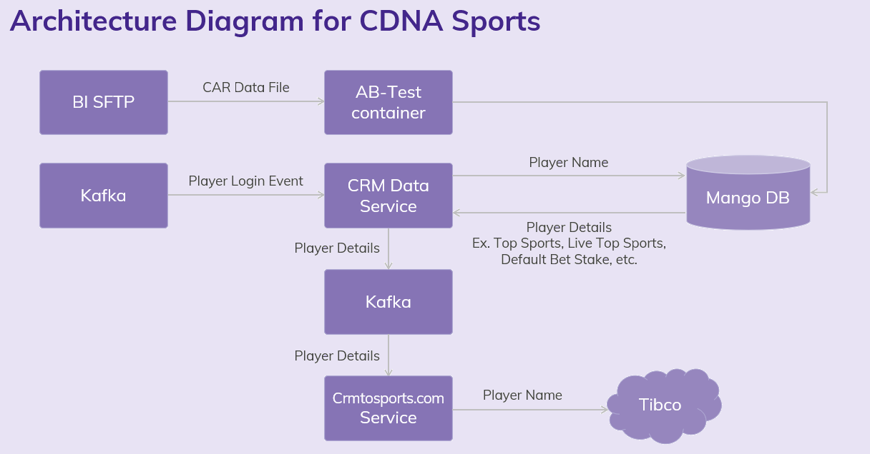
CDNA Sports
Business use case
Technical description
Architecture/Design: Every day BI pushes CAR data file to SFTP, CIP processes this file and persists the data into Mongo DB. On every login CRM data service will fetch the data from mongo and sends to crmtosportscomm, crmtosportscomm publishes data to sports Tibco..
Problem description: To recommend Top Sports, Live Sports, Default Bet Amount to the players.
Label(s) impacted: bwin.com.
Action taken: Consume Top Sports, Live Sports, Default Bet Amount from CAR data file from BI and serve this data to sports team through Tibco.
Business benefit: Recommendation of Top Sports, Live Sports, Default Bet Amount to the players will be provided based on his behavioral activities.
Notes:
Four key points

Slide 11
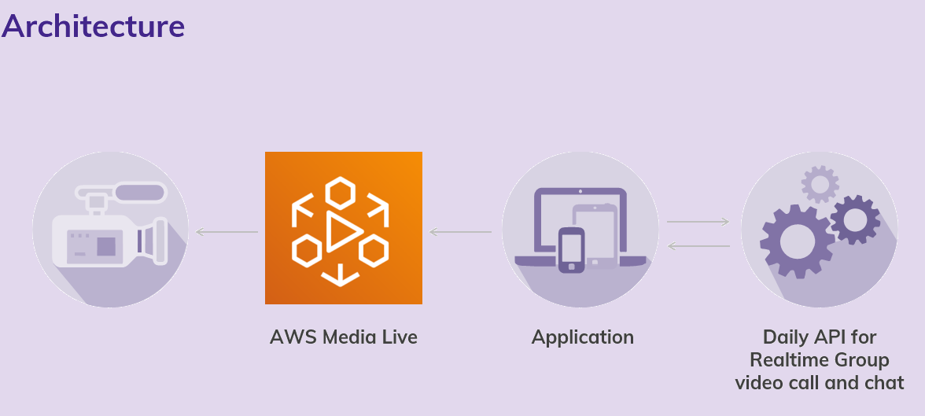
Stream and Bet
Business use case
Technical description
Problem description: Allowing the user for chatting while streaming , allowing the multiuser sync while streaming.
Below is the process of consuming the data.
Consuming the live feed via Aws Media Live.
Using the daily api for real time group video and chat.
created application that consume live video from AWS and uses the Daily api for Realtime group video and chat.
Notes:
Four key points

Slide 12
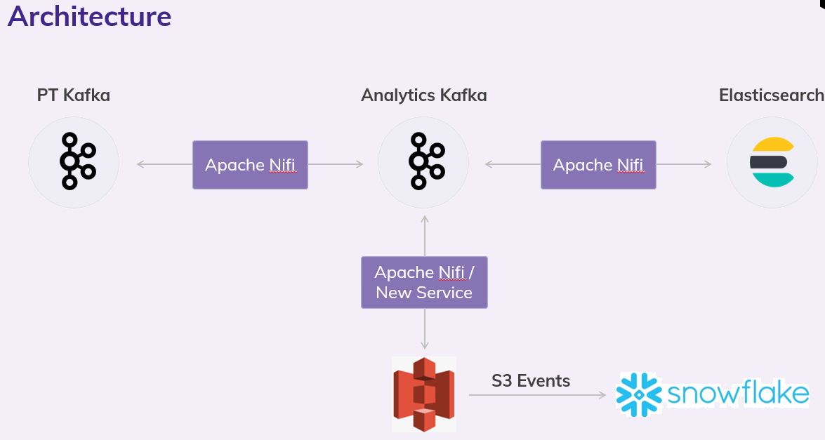
Play Tech integration
Business use case
Technical description
Problem description: Playtech exposes a rich API for live casino. The request is to bring this data into a data store that is accessible to Analysts and from which they can create dashboards to support Casino operations.
Business benefit: Analysts can visualize the data and make necessary recommendations to support casino operations.
Below is the process of consuming the data.
Consuming the data from Playtech Kafka and pushing to S3.
Snowpipe has been configured at the snowflake side which will be listening to S3 events and consume the data as they appear
Notes:
Four key points

Slide 13
Phone & Email Encryption for Snapchat integration
Business use case
Technical description
Problem description: Phone and Email details of players are sent to Snapchat for audience segmentation.
Label(s) impacted: Entain and LCG labels players data are sent.
Action taken: AAM Segmented audience created at Snapchat , encrypted player mobile, email details are sent to Snapchat to segmented audience.
Business benefit:
By sending this information to Snapchat , players can see the advertisements related to Entain games/promotions.
Source Events: AAM segmented players list is collected with help of DMP Destinations, and these players are used to create Snapchat segmented audience.
Architecture:
Adobe DMP
Data Central Exchange
Kafka
DUS
Snapchat
Mango DB
SQL DB
Notes:
Four key points

Slide 14
Scout Integration
Business use case
Technical description
Problem description: To identify the anti money laundering players and take a corrective action to avoid these in future.
Label(s) impacted: All major locations in UK
Action taken: Detecting fraudulent players , money laundering identification.
Business benefit: System can identify the fraudulent players and take a corrective action to avoid these in future.
Source Events: Player data collected from BI is used for triggering Scout API end points.
Notes:
Four key points

Slide 15
Long Sessions
Business use case
Technical description
Problem description:
In order to enforce a break during the long play duration for safer gambling.
Label(s) impacted: LCG.
Action taken: ADA model calculates the player’s active session time between login and logout and sends the session active time for every 5 minutes.
Business benefit: Duration of play time is tracked to enforce a break to avoid addiction to gambling for player’s safety in regards to health and wealth.
Architecture: CIP consumes long session events from ADA models and passed to platform team. Then players break time will be enforced.
Source Events: Long Session events are routed to platform with help of analytics ESB.
Feedback Events: ACTIVE_SESSION_DURATION_EVENT.
Notes:
Four key points

Slide 16
Play Breaks
Business use case
Technical description
Problem description: Play Break alerts will be triggered to players based on configuration done by players. These alerts notify the players to take a break.
Label(s) impacted: LCG labels.
Action taken: Restricted the player from playing continuously.
Business benefit: As per the regulatory requirement, and responsible gambling firm perspective, user is saved from Bankruptcy by applying a break to his continuous play.
Architecture: CIP consumes PlayBreak events from ADA models and passed to platform team. Then players break time will be enforced at the front end.
Source Events: Player break events are routed to platform with help of analytics ESB.
USER_INTERACTION_FEEDBACK_EVENT,BREAK_ENFORCEMENT_EVENT, BREAK_TERMINATION_EVENT, BREAK_WHITELIST_ADD_EVENT, BREAK_WHITELIST_REMOVE_EVENT,PLAY_BREAK_CHANGE_EVENT.
Feedback Events: THRESHOLD_BREACH_EVENT.
Notes:
Four key points

Slide 17
CASIA - 7302 - Risky Games(E-34559)
Business use case
Technical description
Problem description:
System should have capability to recommended safer games to the Players who are losing money while continuously playing certain games.
Label(s) impacted: GVC, LCG, US
Action taken:
CIP consumes risky games from ADA models and serves to Casino further avoiding in displaying these games to players.
Business benefit: A player is recommended with safe games thus by avoiding display of risky games which will benefit them from losing money.
Architecture: CIP consumes risky games from ADA models through analytical ESB and serves to Casino.
Feedback Events: Risky games events are routed with help of analytics ESB to platform.
Notes:
Four key points

Slide 18
Graphyte Integration
Business use case
Technical description
Problem description:
System should have capability to recommend games based on their behavior.
Label(s) impacted: All Labels.
Action taken: Sending the player’s behavioral data to Graphyte system.
Business benefit: Significantly more personalized customer experience and increase in CTR (click through rate).
Architecture: Snowplow services collects the player’s behavioral data from front end and send this data to Graphyte.
Source Events:
Deposit,firstDeposit,gameOpen,loginSuccess,pageView,registrationSuccess,withdrawal,gameClose
Notes:
Four key points

Slide 20
NIFI Source Control
Business use case
Technical description
Problem description: Currently all the NIFI Flows are not versioned backed up anywhere.
Label(s) impacted: All GVC,LCG,US Label.
Action taken: Introduced NIFI Registry which is used for versioning of NIFI Flows and also can backup these versioned flows..
Business benefit: Safer control over NIFI Flows as there will be no loss of NIFI flows and also provision for switching back to any version of the flow,
Architecture/Design: Built the Hadoop with Components HDFS, Yarn, Spark, Hive, Hue.
HDFS: HDFS is Hadoop filesystems to store the transactional, Behavioral data.
Spark: Spark is a fast and general processing engine compatible with Hadoop data.
Yarn: Yarn manages the resources in the Hadoop cluster.
Hive: Hive gives an SQL-like interface to query data stored in various databases and file systems that integrate with Hadoop. Hue: Hue is a web-based tool to access the data from Hadoop and provide the visualizations instantly.
Hue: Hue is a web-based tool to access the data from Hadoop and provide the visualizations instantly .
Notes:
Four key points

